Slide 1

STRATEGIC MANAGEMENT FOR VALUE CREATION
.
DR ADELANKE PETER OYINTOKE DFCISM, ACA, MNIM,FCIA,
Director of Strategic Manager CIISM
Chartered Institute of Information and Strategy Management
Ciismng@gmail.com; 08080029271

Slide 2
THE CONCEPT OF STRATEGY
The Concept of Strategy and the Pursuit of Sustainable Above-Normal Profits
Notes:
1
1
1

Slide 3

Domain of Strategy
strategic competitiveness and above normal returns
concerns managerial decisions and actions which materially affect the success and survival of business enterprises
involves the judgment necessary to strategically position a business and its resources so as to maximize long-term profits in the face of irreducible uncertainty and aggressive competition
strategy is the linkage between a business and its current and future environment
Notes:
2
2
3
routine decisions are not strategic
can be replaced by policy or delegated
Importance of making a decision
Soccer analogy
Road analogy
Macro environment
Stakeholders
suppliers
customers
competitors
Government
Owners
Employees

Slide 4
Definition
The determination of the long run goals and objectives of an enterprise, the adoption of courses of action and the allocation of resources necessary for carrying out these goals
Alfred Chandler, Strategy and Structure
Notes:
8
8
9

Slide 6
STRATEGIC MANAGEMENT
STRATEGIC MANAGEMENT is the process of setting goals, procedures and objectives in order to make a company or organization more competitive .
Goal setting . SMART –Specific -Measurable –Attainable – Relevant- Time-bound
FAST GOALS stand for frequently discussed -Ambitious –Specific –Transparent.

Slide 7
Levels of Strategy
CORPORATE
STRATEGY
CORPORATE
HEAD OFFICE
BUSINESS
STRATEGY
Division A
Division B
R & D
R & D
FUNCTIONAL
STRATEGIES
Personnel
Personnel
Finance
Finance
Production
Production
Marketing/Sales
Marketing/Sales
Notes:
20
20

Slide 8
Levels of Strategy
Corporate strategy... defines the scope of the business in terms of the industries and markets in which it competes.
  includes decisions about diversification, vertical integration, acquisitions, new ventures, divestments, allocation of scarce resources between business units
Business strategy... is concerned with how the firm competes within a particular industry or market... to win a business unit must adopt a strategy that establishes a competitive advantage over its rivals.
Functional strategy... the detailed deployment of resources at the operational level
Notes:
19
19
14

Slide 9
Common Elements in Successful Strategy
Successful Strategy
EFFECTIVE IMPLEMENTATION
Long-term, simple
Profound
Objective
and agreed upon
understanding of
appraisal of
objectives
the competitive
resources
environment
$
Notes:
2

Slide 10
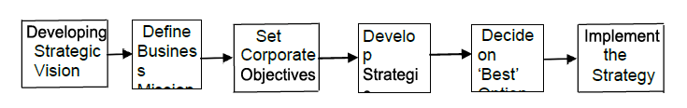
Process of Strategic Planning or Formulation

Slide 11
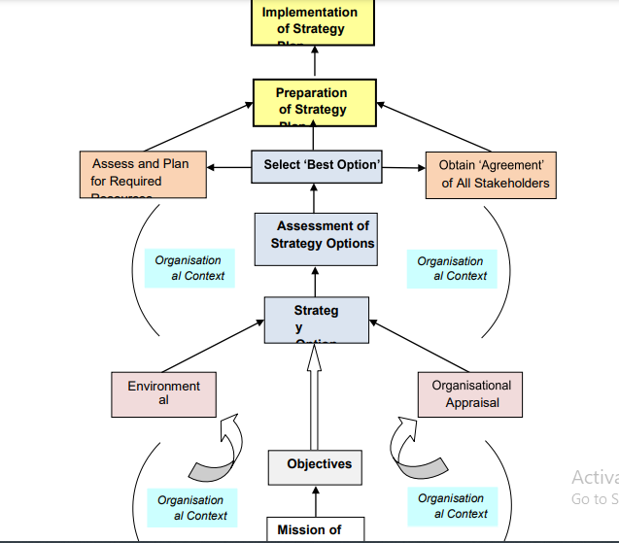
Structure for ‘Formulation of Strategic Plan’ for an Organization

Slide 12
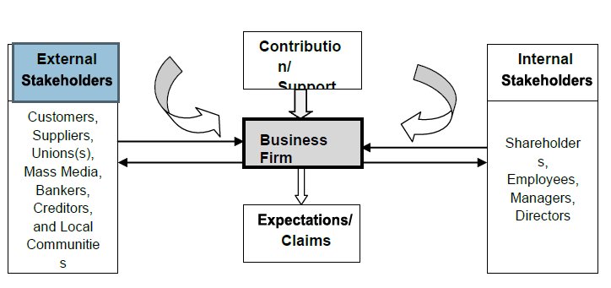
The Organization-Stakeholder Relationship

Slide 13
Strategy as a Quest for Profit
The stakeholder approach : The firm is a coalition of interest groups—it seeks to balance their different objectives
The shareholder approach : The firm exists to maximize the wealth of
its owners (= max. present value of profits over the life of the firm)
For the purposes of strategy analysis we assume that the primary goal of the firm is profit maximization.
Rationale:
Boards of directors legally obliged to pursue shareholder interest
To replace assets firm must earn return on capital > cost of capital
(difficult when competition strong).
Firms that do not max. stock-market value will be acquired
Hence: Strategy analysis is concerned with identifying and accessing the sources of profit available to the firm
Notes:
13

Slide 14
From Profit Maximization to Value Maximization
Profit maximization an ambiguous goal
  Total profit vs. Rate of profit
  Over what time period?
  What measure of profit?
  Accounting profit versus economic profit (e.g. Economic Value Added: Post-tax operating profit less cost of capital
Maximizing the value of the firm:
Max. net present value of free cash flows: _{max. V = Σt} C_{t}
(1 + r)^{t}
Where: V market value of the firm.
C_{t} free cash flow in time t
r weighted average cost of capital

Slide 15
Shareholder Value Maximization and Strategy Choice
The Value Maximizing Approach to Strategy Formulation:
Identify strategy alternatives
Estimate cash flows associated with cash strategy
Estimate cost of capital for each strategy
Select the strategy which generates the highest NPV
Problems:
Estimating cash flows beyond 2-3 years is difficult
Value of firm depends on option value as well as DCF value
Implications for strategy analysis:
Some simple financial guidelines for value maximization
  On existing assets—maximize after-tax rate of return
  On new investment—seek rate of return > cost of capital
Utilize qualitative strategy analysis to evaluate future profit potential

Slide 16
A Comprehensive Value Metrics Framework
Shareholder
Value
Measures:
Market value of the
firm
Market value added
(MVA)
Return to
shareholders
Intrinsic
Value
Measures:
Discounted cash
flows
Real option values
Financial
Indicators
Measures:
Return on Capital
Growth (of
revenues & operating
profits
Economic profit (EVA)
Value
Drivers
Sources:
Market share
Scale economies
Innovation
Brands

Slide 17
Sources of Superior Performance
Above Normal Profits
(in Excess of the Competitive Level)
Avoid
Competitors
Be Better Than
Competition
Attractive
Industry
Attractive
Strategic Group
Attractive
Niche
Cost
Advantage
Differentiation
Advantage
Entry Barriers
Mobility Barriers
Isolating Mechanisms

Slide 18
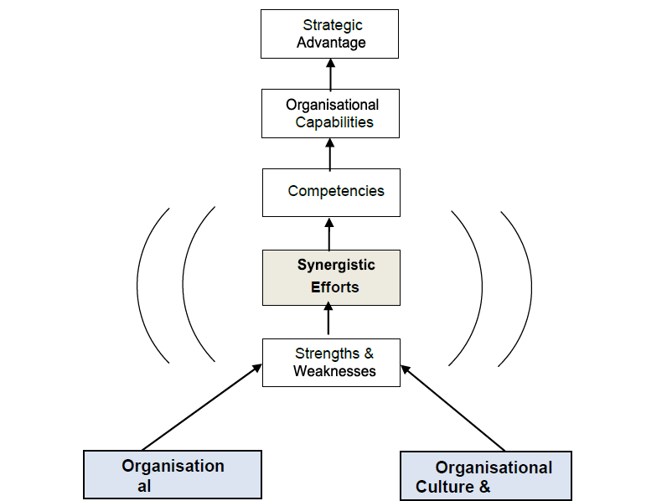
Framework for ‘Development of Strategic Advantage’ for an Organization

Slide 19
Sources of Competitive Advantage
COST
ADVANTAGE
Similar product
at lower cost
COMPETITIVE
ADVANTAGE
Price premium
from unique product
DIFFERENTIATION
ADVANTAGE
Notes:
6

Slide 20
Drivers of Cost Advantage
ECONOMIES OF SCALE
Indivisibli\ties
Specialization and division of labor
ECONOMIES OF LEARNING
Increased dexterity
Improved organizational routines
Process innovation
Reengineering business processes
PRODUCTION TECHNIQUES
PRODUCT DESIGN
Standardizing designs & components
Design for manufacture
Location advantages
Ownership of low-cost inputs
Non-union labor
Bargaining power
INPUT COSTS
CAPACITY UTILIZATION
Ratio of fixed to variable costs
Speed of capacity adjustment
RESIDUAL EFFICIENCY
Organizational slack; Motivation &
culture; Managerial efficiency
Notes:
13

Slide 21
The Nature of Differentiation
DEFINITION: “Providing something unique that is valuable to the
buyer beyond simply offering a low price.” (M. Porter)
THE KEY IS TO CREATE VALUE FOR THE CUSTOMER
TANGIBLE DIFFERENTATION
Observable product characteristics:
size, color, materials, etc.
performance
packaging
complementary services
INTANGIBLE DIFFERENTATION
Unobservable and subjective
characteristics that appeal to customer’s image, status, identity, and desire for exclusivity
TOTAL CUSTOMER RESPONSIVENESS
Differentiation not just about the product, it embraces the whole
relationship between the supplier and the customer.
Notes:
24

Slide 22
Identifying Differentiation Potential:
The Demand Side
THE PRODUCT
What needs does it satisfy?
What are key attributes?
FORMULATE DIFFERENTIATION STRATEGY
Select product positioning in relation to product attributes
Select target customer group
Ensure customer / product compatibility
Evaluate costs and benefits of differentiation
Relate patterns of customer preferences to product attributes
By what criteria do they choose?
THE CUSTOMER
What price premiums do product attributes command?
What motivates them?
What are demographic, sociological, psychological correlates of customer behavior?
Notes:
29

Slide 23
Using the Value Chain to Identify Differentiation Potential on the Supply Side
MIS that supports fast response capabilities
Training to support customer service excellence
Unique product features. Fast new product development
FIRM INFRASTRUCTURE
HUMAN RESOURCE MANAGEMENT
TECHNOLOGY DEVELOPMENT
INBOUND OPERATIONS OUTBOUND MARKETING SERVICE
LOGISTICS LOGISTICS & SALES
Customer technical support. Consumer credit. Availability of spares
Quality of components & materials
Defect free products. Wide variety
Fast delivery. Efficient order processing
Building brand reputation
Notes:
35

Slide 24
INDUSTRY ANALYSIS AND POSITIONING
Determining Industry Attractiveness and Identifying Strategic Opportunities
Notes:
1
1
1

Slide 25
From Environmental Analysis to Industry Analysis
The national/ international economy
The natural environment
THE INDUSTRY
ENVIRONMENT
Suppliers
Competitors
Customers
Demographic structure
Technology
Government
& Politics
Social structure
Social structure
The Industry Environment lies at the core of the Macro Environment.
The Macro Environment impacts the firm through its effect on the Industry
Environment.
Notes:
3

Slide 26
Porter’s Five Forces of Competition Framework
SUPPLIERS
Bargaining power of suppliers
INDUSTRY
COMPETITORS
Threat of
substitutes
POTENTIAL
ENTRANTS
Threat of
new entrants
SUBSTITUTES
Rivalry among
existing firms
Bargaining power of buyers
BUYERS
Notes:
7

Slide 27
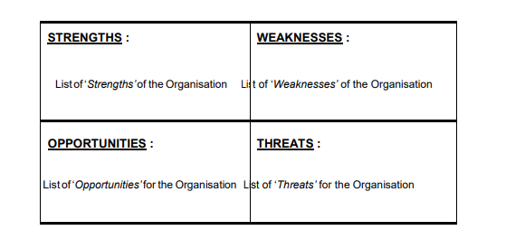
Value Chain Analysis – Porter’s Generic Value Chain

Slide 28
The Structural Determinants of Competition
SUPPLIER POWER
Supplier concentration
Relative bargaining
power
THREAT OF ENTRY
Capital requirements
Economies of scale
Absolute cost advantage
Product differentiation
Access to distribution
channels
Legal/ regulatory barriers
Retaliation
INDUSTRY RIVALRY
Concentration
Diversity of
competitors
Product differentiation
Excess capacity &
exit barriers
Cost conditions
SUBSTITUTE
COMPETITION
Buyers’ propensity
to substitute
Relative prices &
performance of
substitutes
BUYER POWER
Buyers’ price sensitivity
Relative bargaining
power
Notes:
7

Slide 29
Applying Five-Forces Analysis
Forecasting Industry Profitability
    Past profitability a poor indicator of future profitability.
    If we can forecast changes in industry structure we can predict likely impact on competition and profitability.
Strategies to Improve Industry Profitability
    What structural variables are depressing profitability
    Which of these variables can be changed by individual or collective strategies?
Notes:
14

Slide 30
Neutralizing The Five
Competitive Forces
Force
Entry
Rivalry
Substitutes
Buyers
Suppliers
Method for Neutralizing Force
Erecting barriers (isolating mechanisms) create & exploit economies of scale, aggressive deterrence, design in switching costs, etc.
Compete on nonprice dimensions: cost leadership, differentiation, cooperation, etc.
Improve attractiveness compared to substitutes: better service, more features, etc..
Reduce buyer uniqueness: forward integrate, differentiate product, new customers, etc..
Reduce supplier uniqueness: backward integrate, obtain minority position, second source, etc..

Slide 31
The Driving Forces of Industry Evolution
BASIC CONDITIONS INDUSTRY STRUCTURE COMPETITION
Customers become
more knowledgeable
& experienced
Customers become
more price conscious
Quest for new
sources of
differentiation
Products become
more standardized
Diffusion of
technology
Price competition
intensifies
Production
becomes less R&D
& skill-intensive
Production shifts
to low-wage
countries
Excess capacity
increases
Demand growth
slows as market
saturation approaches
Bargaining power
of distributors
increases
Distribution channels
consolidate
Notes:
44

Slide 32
Preparing for the Future : The Role of Scenario Analysis in Adapting to Industry Change
Stages in undertaking multiple Scenario Analysis:
    Identify major forces driving industry change
    Predict possible impacts of each force on the industry environment
    Identify interactions between different external forces
    Among range of outcomes, identify 2-4 most likely/ most interesting scenarios: configurations of changes and outcomes
    Consider implications of each scenario for the company
    Identify key signposts pointing toward the emergence of each scenario
    Prepare contingency plan

Slide 33
RESOURCES, CAPABILITIES, AND CORE COMPETENCES
Notes:
1
1
1

Slide 34
Shifting the Focus of Strategy Analysis:
From the External to the Internal Environment
THE FIRM
Goals and
Values
Resources and
Capabilities
Structure and
Systems
THE
INDUSTRY
ENVIRONMENT
Competitors
Customers
Suppliers
STRATEGY
STRATEGY
The
Firm-Strategy
Interface
The
Environment-Strategy
Interface
Notes:
5

Slide 35
Rationale for the Resource-based Approach to Strategy
When the external environment is subject to rapid change, internal resources and capabilities offer a more secure basis for strategy than market focus.
Resources and capabilities are the primary sources of profitability.

Slide 36
The Links between Resources, Capabilities
and Competitive Advantage
INDUSTRY KEY
SUCCESS FACTORS
COMPETITIVE
ADVANTAGE
STRATEGY
ORGANIZATIONAL
CAPABILITIES
RESOURCES
TANGIBLE INTANGIBLE HUMAN
Financial
Physical
Skills/know-how
Capacity for communication & collaboration
Motivation
Technology
Reputation
Culture

Slide 37
Defining Organizational Capabilities
Organizational Capabilities = firm’s capacity for undertaking a particular activity. (Grant)
Distinctive Competence = things that an organization does particularly well relative to competitors. (Selznick)
Core Competence = capabilities that are fundamental to a firm’s strategy and performance. (Hamel and Prahalad)
Notes:
16
16
15

Slide 38
Identifying Organizational Capabilities:
A Functional Classification
FUNCTION CAPABILITY EXEMPLARS
Corporate Financial management ExxonMobil, GE
Management Strategic control IBM, Samsung
Coordinating business units BP, P&G
Managing acquisitions Citigroup, Cisco
MIS Speed and responsiveness through Wal-Mart, Dell
rapid information transfer Capital One
R&D Research capability Merck, IBM
Development of innovative new products Apple, 3M
Manufacturing Efficient volume manufacturing Briggs & Stratton
Continuous Improvement Nucor, Harley-D
Flexibility Zara, Four Seasons
Design Design Capability Apple, Nokia
Marketing Brand Management P&G, LVMH
Quality reputation Johnson & Johnson
Responsiveness to market trends MTV, L’Oreal
Sales, Distribution Sales Responsiveness PepsiCo, Pfizer
& Service Efficiency and speed of distribution LL Bean, Dell
Customer Service Singapore Airlines
Caterpillar

Slide 39
The Porter Value Chain
FIRM INFRASTRUCTURE
HUMAN RESOURCE MANAGEMENT
TECHNOLOGY DEVELOPMENT
PROCUREMENT
INBOUND OPERATIONS OUTBOUND MARKETING SERVICE
LOGISTICS LOGISTICS & SALES
SUPPORT
ACTIVITIES
PRIMARY
ACTIVITIES
Notes:
6
6

Slide 40
The Rent-Earning Potential of Resources and Capabilities
THE EXTENT OF THE
COMPETITIVE ADVANTAGE
ESTABLISHED
Scarcity
Relevance
Durability
THE PROFIT
EARNING POTENTIAL
OF A RESOURCE OR
CAPABILITY
SUSTAINABILITY OF THE
COMPETITIVE ADVANTAGE
Transferability
Replicability
Property rights
Relative
bargaining power
APPROPRIABILITY
Embeddedness
Notes:
8
8

Slide 41
Approaches to Capability Development
Acquire and develop the underlying resources. Especially human resources
--Externally (hiring)
--Internally through developing individual skills
Acquire/access capabilities externally through acquisition or
alliance
Greenfield development of capabilities in separate organizational unit (IBM & the PC, Xerox & PARC, GM & Saturn)
Build team-based capabilities through training and team development (i.e. develop organizational routines)
Align structure & systems with required capabilities
Change management to transform values and behaviors (GE, BP)
Product sequencing (Intel , Sony, Hyundai)
Knowledge Management (systematic approaches to acquiring, storing, replicating, and accessing knowledge)

Slide 42
COMPETITIVE ADVANTAGE AND THE SCOPE OF THE FIRM
Notes:
1
1
1

Slide 43
From Business Strategy to Corporate Strategy: The Scope of the Firm
Business Strategy is concerned with how a firm computes within a particular market
Corporate Strategy is concerned with where a firm competes, i.e. the scope of its activities
The dimensions of scope are
      product scope
      vertical scope
      geographical scope
Notes:
34

Slide 44
The Basic Issues in Diversification Decisions
Superior profit derives from two sources:
INDUSTRY
ATTRACTIVENESS
RATE OF PROFIT
> COST OF CAPITAL
COMPETITIVE
ADVANTAGE
Diversification decisions involve these same two issues:
How attractive is the sector to be entered?
Can the firm achieve a competitive advantage?

Slide 45
Motives for Diversification
GROWTH --The desire to escape stagnant or declining industries is a powerful motive for diversification (e.g. tobacco,
oil, newspapers).
--But, growth satisfies managers not shareholders.
--Growth strategies (esp. by acquisition), tend to
destroy shareholder value
RISK --Diversification reduces variance of profit flows
SPREADING --But, doesn’t create value for shareholders—they can
hold diversified portfolios of securities.
--Capital Asset Pricing Model shows that diversification
lowers unsystematic risk not systematic risk.
PROFIT --For diversification to create shareholder value, then
bringing together of different businesses under
common ownership & must somehow increase
their profitability.
Notes:
31

Slide 46
Diversification and Shareholder Value: Porter’s Three Essential Tests
If diversification is to create shareholder value, it must meet three tests:
1. The Attractiveness Test: diversification must be directed towards attractive industries (or have the potential to become attractive).
2. The Cost of Entry Test: the cost of entry must not capitalize all future profits.
3. The Better-Off Test: either the new unit must gain competitive advantage from its link with the company, or vice-versa. (i.e. some form of “synergy” must be present)
Additional source of value from diversification: Option value
Notes:
32

Slide 47
Competitive Advantage from Diversification
        Sharing tangible resources (research labs, distribution systems) across multiple businesses
        Sharing intangible resources (brands, technology) across multiple businesses
        Transferring functional capabilities (marketing, product development) across businesses
        Applying general management capabilities to multiple businesses
ECONOMIES
OF
SCOPE
        Economies of scope not a sufficient basis for diversification ----must be supported by transaction costs
        Diversification firm can avoid transaction costs by operating internal capital and labor markets
        Key advantage of diversified firm over external markets--- superior access to information
ECONOMIES
FROM
INTERNALIZING
TRANSACTIONS

Slide 48
Relatedness in Diversification
Economies of scope in diversification derive from two types of relatedness:
Operational Relatedness-- synergies from sharing resources across businesses (common distribution facilities, brands, joint R&D)
Strategic Relatedness-- synergies at the corporate level deriving from the ability to apply common management capabilities to different businesses.
Problem of operational relatedness:- the benefits in terms of economies of scope may be dwarfed by the administrative costs involved in their exploitation.
Notes:
35

Slide 49
Transactions Costs and The Existence of the Firm
Transaction cost theory explains not just the boundaries
of firms, also the existence of firms.
In 18th century English woollen industry, no firms –
independent spinners and weavers linked by merchants.
Residential remodeling industry -- mainly independent self-
employed builders, plumbers, electricians, painters.
Key issue -- transaction costs of the market vs.
administrative costs of firms.
Where transaction costs high—firm is more efficient means
of organization
Note: transaction costs comprise costs of search and contract negotiation and enforcement
Notes:
36

Slide 50
Gary Hamel: Shaking the Foundations
OLD BRICK
NEW BRICK
Top management is responsible
for setting strategy
Everyone is responsible
for setting strategy
Getting better, getting faster
is the way to win
Rule-busting innovation
is the way to win
IT creates competitive advantage
Unconventional business concepts
create competitive advantage
Being revolutionary is high risk
More of the same is high risk
We can merge our way to
competitiveness
There’s no correlation between
size and competitiveness
Innovation equals new products
and new technology
Innovation equals entirely new
business concepts
Strategy is the easy part,
Implementation the hard part
Strategy is the easy only if you’re
content to be an imitator
Change starts at the top
Change starts with activists
Our real problem is execution
Our real problem is innovation
Big companies can’t innovate
Big companies can become gray-haired
revolutionaries

Slide 51
Thank You!

